Slide 1
Electronic parts of Calibration LED Chart 2022.09.20

Slide 2
CONCEPT1 (* All Channels Individually Control)
- System Overview
LED Board1
40(8x5) Leds
LED Board3
40(8x5) Leds
LED Board5
40(8x5) Leds
LED Board7
40(8x5) Leds
LED Board9
40(8x5) Leds
LED Board2
40(8x5) Leds
LED Board4
40(8x5) Leds
LED Board6
40(8x5) Leds
LED Board8
40(8x5) Leds
LED Board10
40(8x5) Leds
Host
(PC or etc)
Control Board1
(2 LED Boards controlled)
Control Board2
(2 LED Boards controlled)
Control Board3
(2 LED Boards controlled)
Control Board4
(2 LED Boards controlled)
Control Board5
(2 LED Boards controlled)

Slide 3
CONCEPT1 (* All Channels Individually Control)
- Block Diagram of Control board
Driver1
LED1
Driver2
LED2
DAC 1(8CH)
…
Driver8
LED8
CPU1
…
…
X 5
Driver73
LED73
DAC 10(8CH)
Driver74
LED74
Driver80
LED80

Slide 4

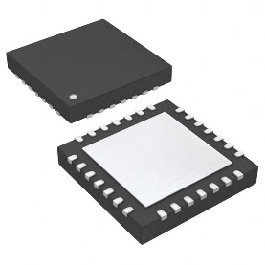
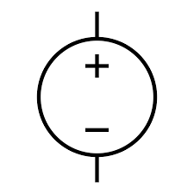

CONCEPT1 (* All Channels Individually Control)
- Detail configuration of one channel
DUTs
(* Common Cathode)

Slide 5
CONCEPT2 (* All Channels Simultaneously Control)
- System Overview
electric circuit board
LED Board1
40(8x5) Leds
LED Board3
40(8x5) Leds
LED Board5
40(8x5) Leds
LED Board7
40(8x5) Leds
LED Board9
40(8x5) Leds
LED Board2
40(8x5) Leds
LED Board4
40(8x5) Leds
LED Board6
40(8x5) Leds
LED Board8
40(8x5) Leds
LED Board10
40(8x5) Leds
Host
(PC or etc)
Control Board
(All LED Boards controlled)

Slide 6
CONCEPT2 (* All Channels Simultaneously Control)
- Block Diagram of Control board
Mirror Driver1
LED1
Mirror Driver2
LED2
CPU1
Ref Driver
…
Mirror Driver399
LED399
Mirror Driver400
LED400

Slide 7
Maintenance
Keep spare parts and replace them immediately in case of problems. After that, the defective module can be repaired at KIMSOPTEC.
If the electrical and physical specifications are met, it is okay to replace the LED of another wavelength.
LED Board3
40(8x5) Leds
Spare LED Board
40(8x5) Leds
If some LEDs
Broken
electric circuit board
LED Board1
40(8x5) Leds
LED Board5
40(8x5) Leds
LED Board7
40(8x5) Leds
LED Board9
40(8x5) Leds
LED Board2
40(8x5) Leds
LED Board4
40(8x5) Leds
LED Board6
40(8x5) Leds
LED Board8
40(8x5) Leds
LED Board10
40(8x5) Leds

Slide 8
THANK YOU
for your attention!

